Slide 1
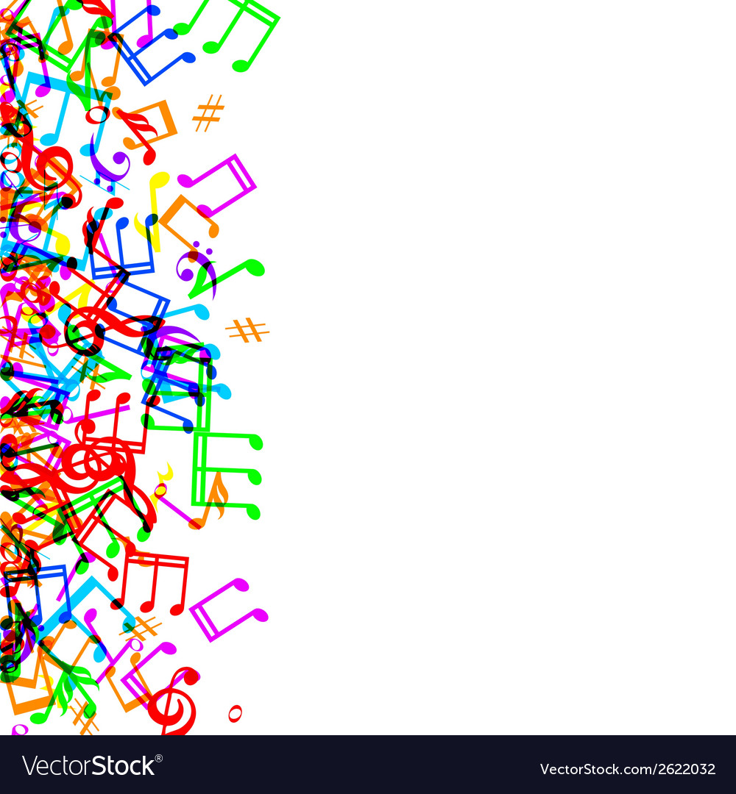
SMSJ Music day 2022
Research has shown that listening to music can reduce anxiety, blood pressure, and pain as well as improve sleep quality, mood, mental alertness, and memory.

Slide 2
Music day – valuing traditions and cultures.
Music/literacy (written or video recorded) – Music has a direct impact upon how we feel. Some songs can make us feel happy and want to dance, others can make you feel relaxed or even quite sad. I would like you to listen to your class song and tell me about how it makes you feel. Do you like it? What is it you do/don’t like about it?
I would also love to hear about your favourite song. What is it? Is there a certain time or place that you enjoy listening to it? I would like to know why you like it and how it makes you feel.
Music/maths – How many different ways can you create a four beat rhythm? *Challenge for UKS2 – can you write this on a musical stave in note form? Can you play it on an instrument?
Music TAC afternoon – listen to a piece of music from different countries. In your teams, use the instruments provided to complete the TAC related to your class song! Think about the speed/tempo of the music. Is it loud, quiet, or a mixture of the two? Does is have long notes or short notes? What kind of instruments can you hear?

Slide 3
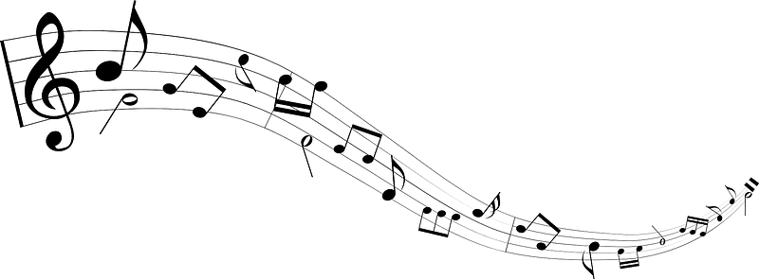
Reception class
China!
Create music for a Chinese New Year celebration.
Sing, dance and play instruments for a Chinese New Year parade.
Singing and playing instruments (drums and cymbals) in time with the music following Chinese new year song.
https://www.youtube.com/watch?v=8etqkmb7Ybs
Sing, dance and play instruments in time with the music - https://www.youtube.com/watch?v=by5sTzh67fU

Slide 4
Year 1
Your class song is the Brazilian Samba, Fanfarra (Cabua-le-le)
https://www.youtube.com/watch?v=8TI8av3c_20
What instruments can you hear?
How does it make you feel?
What is the tempo/speed of the music? Does it stay the same throughout the song or does it change?
For your TAC, I want you to think about the tempo and include a call and response element to your music!
‘A “phrase” of music serves as the “call,” and is “answered” by a different phrase of music.’

Slide 5
Year 2
Your class song is the Indonesian Gamalan,
https://www.youtube.com/watch?v=57pYDGupre4
What instruments can you hear?
How does it make you feel?
What is the tempo/speed of the music? Does it stay the same throughout the song or does it change?
After watching the following videos, my TAC for you is to create your own Gamalan rhythm, with the extra challenge of including a crescendo (getting louder) and decrescendo (getting softer/quieter).
https://www.youtube.com/watch?v=l8OcXfyHcQM
https://www.youtube.com/watch?v=5GP_WssNcMo
In written music, a crescendo and decrescendo look like this:

Slide 6
Year 3
Your class song is the Indian Classical Sahela Re, by Kishori Amonkar
https://www.youtube.com/watch?v=ipauyMfVYso
What instruments can you hear?
How does it make you feel?
What is the tempo/speed of the music? Does it stay the same throughout the song or does it change?
TAC
In response to our healthy mind, body and spirit week, I would like you to take inspiration from your class song to create a relaxing rhythm on the drums and a string instrument (using it gently, one string at a time). As an added challenge I would like you to include a piano (quiet) and forte (loud) element into your rhythm.

Slide 7
Year 4
Your class song is the Calypso, Tropical Bird by the Trinidad Steel Band
https://www.youtube.com/results?search_query=tropical+bird+calypso
What instruments can you hear?
How does it make you feel?
What is the tempo/speed of the music? Does it stay the same throughout the song or does it change?
Now watch this video of a choir performing a Calypso song in a 3 part canon/round ☺
https://www.youtube.com/watch?v=sEvFAgdlZDw
Here’s an easier version to follow, which I would like you to try out for you TAC!
https://www.youtube.com/watch?v=zoLTvvVwDeE
Following this, I would like you create some Calypso rhythms on the steel pan drum app. Can you write down these rhythms and perform them to your friends?

Slide 8
Year 5
Your class song is Drums of Passion, Jin-Go-Lo-Ba
https://www.youtube.com/watch?v=ZYhFyF8dvU4
What instruments can you hear?
How does it make you feel?
What is the tempo/speed of the music? Does it stay the same throughout the song or does it change?
My TAC for you is to take inspiration from this style of music to create a rhythm on the drums in ternary form. This is a three-part musical form consisting of an opening section, a following section and then a repetition of the first section (A, B, A). For example, Jin-Go-La-Ba chorus, a verse rhythm, then back to the chorus. Try to write/compose your rhythm.
Challenge yourself to use various dynamics such as forte (loud), piano (quiet), very loud (fortissimo), very quiet (pianissimo), moderately loud (mezzo forte), and moderately quiet (mezzo piano).

Slide 9
Year 6
Your class are going to focus on Folk music, looking at the Wellerman See Shanty song by Nathan Evans!
https://www.youtube.com/watch?v=qP-7GNoDJ5c
For your TAC, I would like you to practice this two part tapping rhythm! Split your groups into two and follow the rhythm.
https://www.youtube.com/watch?v=X1Z8EzlDYSQ
See if you can keep in time with the music, following the music to create one beat or two as directed.
Bonus points if your team can change the lyrics to create your own verse and chorus about life at SMSJ!

Slide 10
Music challenge for over half term!
Miss Boyle’s cousin is a songwriter for many famous singers and he wants to hear from you!
In line with our healthy mind, body and spirit week, he would like you to write your own song or rap about taking care of yourself and having a positive outlook on life. This could be about life in school, at home…anything you like!
The winning song or rap will be sent to Miss Boyle’s cousin for him to put some music to it and create your very own song. This means you have to really think about your lyrics and make them unique and meaningful.
Teachers can be involved too!
Good luck! I can’t wait to see/hear what you create.

